Slide 1
Basic Statistics

Slide 2
Agenda
Statistics Overview
Descriptive V/S Inferential Statistics
Population & Sample
Parameter V/S Statistic
Types of Data
Measures Of Central Tendencies
Measures Of Dispersion
Descriptive Plots

Slide 3
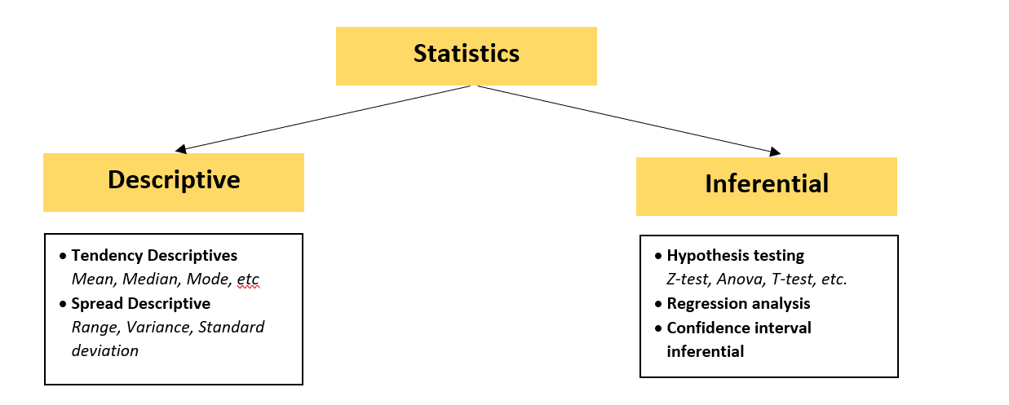
What is Statistics?
Statistics is science of learning from the data. It is the science behind the identification, collection, organization, interpretation, and presentation of data. Data could be qualitative or quantitative. Statistical knowledge helps you use the proper methods to collect the data, employ the correct analyses, and effectively present the results.
What are different types of Statistics?

Slide 4
Descriptive v/s Inferential Statistics
Descriptive Statistics refers to data that shows the fundamental aspects of a selected population. Also, it establishes how it was organized and presented. The data can be analyzed by simply looking at the provided information and referring to how it is arranged. It is further classified as follows.
Tendency Descriptive: It uses simple mathematical calculations and can be analyzed by computing the mean, median, and mode for the data under consideration.
Spread Descriptive: This form focuses on whether different sets of data are relative to each other or not. Generally, it includes a description using variances, deviation methods, range of data, and distribution.
Inferential Statistics focuses on arriving at a conclusion based on the sample evaluation. It is further classified into:
Confidence Interval Inferential: It refers to statistical data drawn from real numbers. However, the parameter concerning its actual data size may not be known.
Hypothesis Inferential: This type analyzes extensive data based on a small sample size.

Slide 5
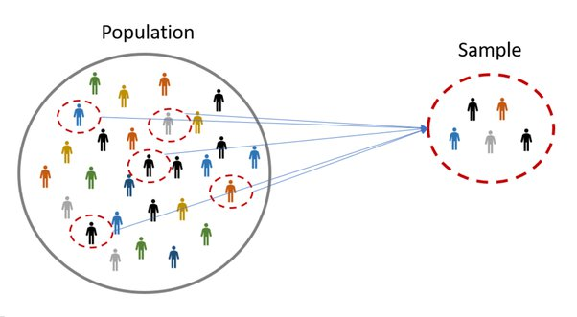
Population v/s Sample
Population is the entire group that you want to draw conclusions about.
Sample is the specific group that you will collect data from. The size of the sample is always less than the total size of the population.
Example:
All the students in the school are the population and the students of class 10 are the sample.
Patients in the hospital are the population and the old age patients are the sample
For good statistical analysis, the sample needs to be as "similar" as possible to the population. If they are similar enough, we say that the sample is representative of the population. The sample is used to make conclusions about the whole population. If the sample is not similar enough to the whole population, the conclusions could be useless.

Slide 6
Parameter vs Statistic
Parameters are numbers that describe the properties of entire populations. Statistics are numbers that describe the properties of samples.
For example, the average income for the United States is a population parameter. Conversely, the average income for a sample drawn from the U.S. is a sample statistic. Both values represent the mean income, but one is a parameter vs a statistic.
Summary Value | Parameter | Statistic
Mean | μ or Mu | x̄ or x-bar
Standard deviation | σ or Sigma | s
Correlation | ρ or rho | r
Proportion | P | p̂ or p-hat

Slide 7
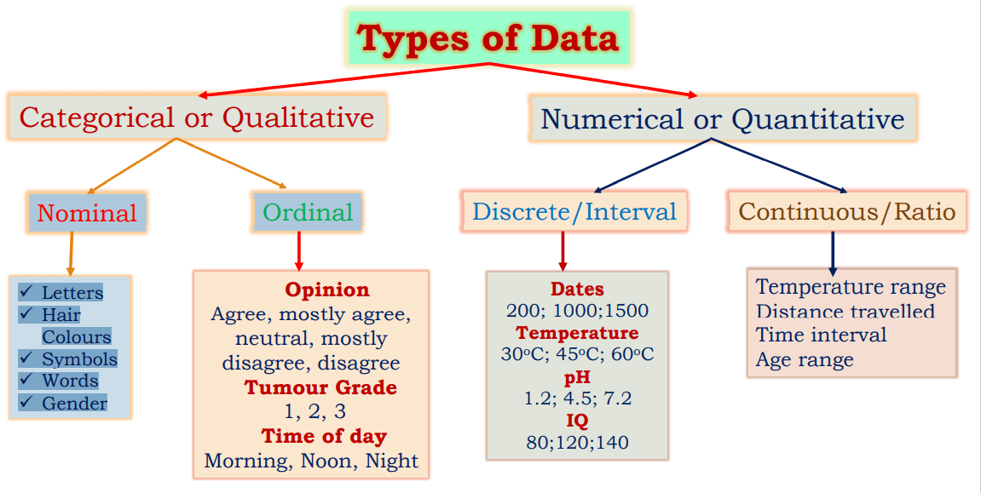
Different Types Of Data

Slide 8
Nominal data
Nominal data are used to label variables where there is no quantitative value and has no order. So, if you change the order of the value then the meaning will remain the same.
Thus, nominal data are observed but not measured, are unordered but non-equidistant, and have no meaningful zero.
For Example
What languages do you speak?
English | German | French | Punjabi
Ordinal data
Ordinal data is almost the same as nominal data but not in the case of order as their categories can be ordered like 1st, 2nd, etc. Ordinal Data is observed but not measured, is ordered but non-equidistant, and has no meaningful zero. Ordinal scales are always used for measuring happiness, satisfaction, etc.
For Example
Opinion
Agree | Disagree | Mostly agree | Neutral | Mostly disagree

Slide 9
Discrete vs Continuous
Discrete data is the type of data that has clear spaces between values. Continuous data is data that falls in a constant sequence.
Discrete data is countable while continuous — measurable.
Discrete Data Examples: The number of students in a class, the number of chocolates in a bag, the number of strings on the guitar, the number of fishes in the aquarium, etc.
Continuous Data Examples: Measurement of height and weight of a student, Daily temperature measurement of a place, Wind speed measured daily, etc.
Interval data
Data that can be ordered and the distance between them is objectively meaningful. But there is no natural 0-value where the scale originates. Interval data can be negative. Any measurement of interval scale can be ranked, counted, subtracted, or added, and equal intervals separate each number on the scale. However, these measurements don’t provide any sense of ratio between one another.
For Example
Years in a calendar
Temperature measured in Fahrenheit

Slide 10
Ratio data
Ratio Data are measured and ordered with equidistant items and a meaningful zero and never be negative like interval data.
An outstanding example of ratio data is the measurement of heights. It could be measured in centimetres, inches, meters, or feet and it is not practicable to have a negative height.
For Example
Age (from 0 years to 100+)
Temperature (in Kelvin, but not °C or F)
Distance (measured with a ruler or any other assessing device)
Time interval (measured with a stop-watch or similar)

Slide 11
Measures Of Central Tendencies

Slide 12


What is Measures of Central Tendencies
A measure of central tendency is a single value that attempts to describe a set of data by identifying the central position within that set of data. As such, measures of central tendency are sometimes called measures of central location. They are also classed as summary statistics.
Mean
The mean is the arithmetic average. You just add up all of the values and divide by the number of observations in your dataset.
Take these two steps to calculate the mean:
Step 1: Add all the scores together
Step 2: Divide the sum by the number of scores used
As an example, imagine that your psychology experiment returned the following number set: 3, 11, 4, 6, 8, 9, 6. To calculate the mean, you first add all the numbers together (3 + 11 + 4 + 6 + 8 + 9 + 6 = 47). Then you divide the total sum by the number of scores used (47 / 7 = 6.7). In this example, the mean or average of the number set is 6.7.

Slide 13
Median
The median is the middle value. It is the value that splits the dataset in half, making it a natural measure of central tendency.
Step 1: Take the two middle numbers of the even-numbered set
Step 2: Add the two numbers together
Step 3: Divide the total by 2
As an example, consider this set of numbers: 5, 9, 11, 9, 7. First, you arrange them in numerical order (5, 7, 9, 9, 11). Since you have an odd number of scores, the number in the third position of the data set is the median which, in this case, is 9 (5, 7, 9, 9, 11).
To calculate the median for an even number of scores, imagine that your research revealed this set of data: 2, 5, 1, 4, 2, 7. Your first step is to put them in numerical order (1, 2, 2, 4, 5, 7). The two middle scores are 2 and 4, so you should add them together (2+4=6) and then divide 6 by 2, which equals 3. In this data set, the median score is 3.

Slide 14
Mode
Of all the measures, finding the mode requires the least amount of mathematical calculation. Instead, since the mode is simply the most frequently occurring score in a distribution, all you do is look at all your scores and select the most common one.
Step 1: Look at all the data scores
Step 2: Identify the data score that appears most often
As an example, consider the following number distribution: 2, 3, 6, 3, 7, 5, 1, 2, 3, 9. The mode of these numbers would be 3 since this is the most frequently occurring number (2, 3, 6, 3, 7, 5, 1, 2, 3, 9).
If no number in a set occurs more than once, there is no mode for that set of data. It's also possible for a data set to have two modes. This is known as bi-modal distribution.
Bi-modal distribution occurs when there are two numbers that are tied in frequency. For example, consider the following set of numbers: 13, 17, 20, 20, 21, 23, 23, 26, 29, 30. In this set, both 20 and 23 occur twice (13, 17, 20, 20, 21, 23, 23, 26, 29, 30). Therefore, they are both modes.

Slide 15
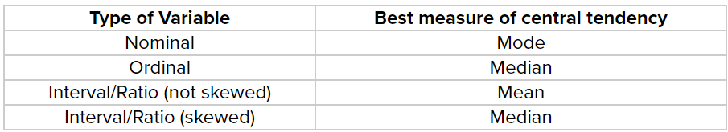
Pros & Cons of Mean, Median & Mode
Each measure of central tendency has its own strengths and weaknesses. Here are a few to consider.
The mean utilizes all numbers in a set to express the measure of central tendency. However, outliers—or data that lies well outside of the data set—can distort the overall measure. For example, a couple of extremely high scores can skew the mean, so that the average score appears much higher than most of the scores actually are.
The median gets rid of outliers or disproportionately high or low scores. At the same time, this could be an issue because it may not adequately represent the full set of numbers.
The mode may be less influenced by outliers as well and is good at representing what is "typical" for a given group of numbers. But it also may be less useful in cases where no number occurs more than once.
When to Use Mean, Median, and Mode

Slide 16
Measures Of Dispersion

Slide 17
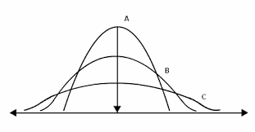
Measures Of Dispersion
What is Dispersion?
In statistics, dispersion (or spread) is a means of describing the extent of distribution of data around a central value or point. It aids in understanding data distribution. Lower dispersion indicates higher precision in the manufacturing process or data measurements, whereas higher dispersion means lower accuracy.
What causes Dispersion?
Dispersion of data happens in statistics because of natural phenomena, irregular behavior of observational data, and due to technical errors of data measuring instruments. All these factors contribute to the dispersion of data in statistics.

Slide 18

Range (R)
Range refers to the difference between the largest and the smallest values in a given data set. The higher the value of the range, the higher the spread in data.
R = L – D
where,
L = Largest value
S = Smallest value
Quartile deviation (QD)
A quartile distributes a data set in four equal valued sets. Each data set has the smallest number, the largest number, and the median. Q2 or second quartile is the median of the data. The first quartile (Q1) connects the smallest number with Q2, while the third quartile (Q3) joins the largest number with Q2.
The interquartile range is the difference between the third quartile and the first quartile. Half of the interquartile range is the quartile deviation.
Hence, Interquartile range (IR) = Q3 – Q1
Refer: - Quartiles & Quantiles | Calculation, Definition & Interpretation

Slide 19



Variance
It is the average of the sum of the square of the difference between each data point from the mean. The higher the variance, the higher the scattering of data from the mean and vice-versa.
Σ = sum of, Χ = each value, μ = mean, Ν = number of values in the dataset
Standard Deviation
It is the most widely used method for measuring spread. Mathematically, it is the square root of the variance.
where,

Slide 20

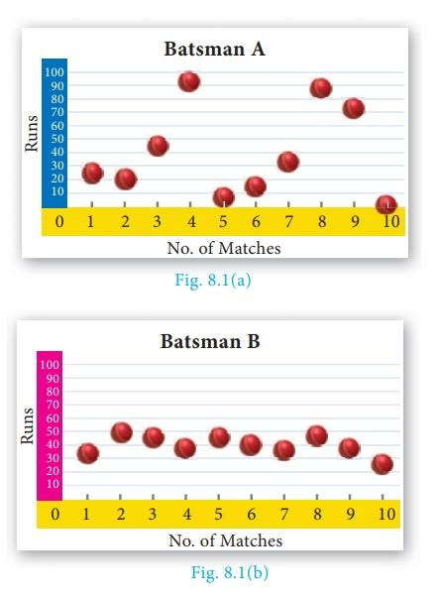
Coefficient of Variation (COV)
It is used to contrast two data sets based on their consistency.
where,
X = Mean
σ = Standard Deviation
Examples
Let us take an example from the stock market domain. A certain security A is being traded on the exchange. The traders who want to invest in security A will look at its historical return data for the last year. They will assess the extent of scattering of the security’s return over the past year.
The following data provide the runs scored by two batsmen in the last 10 matches.
Batsman A: 25, 20, 45, 93, 8, 14, 32, 87, 72, 4
Batsman B: 33, 50, 47, 38, 45, 40, 36, 48, 37, 26
Mean of Batsman A is 40 & Mean of Batsman B is also 40

Slide 21
Descriptive Plots
Univariate Descriptive
Univariate descriptive statistics are helpful when it comes to summarizing huge amounts of numerical data as well as revealing patterns in the raw data. Patterns discovered in univariate data may be described using central tendency (mean, mode, and median), as well as dispersion: variance, range, quartiles, standard deviations, maximum, and minimum.
When dealing with univariate data, you have numerous alternatives for defining it.
Frequency Distribution Table
Histograms
Bar Charts
Pie Charts
Frequency Polygon

Slide 22
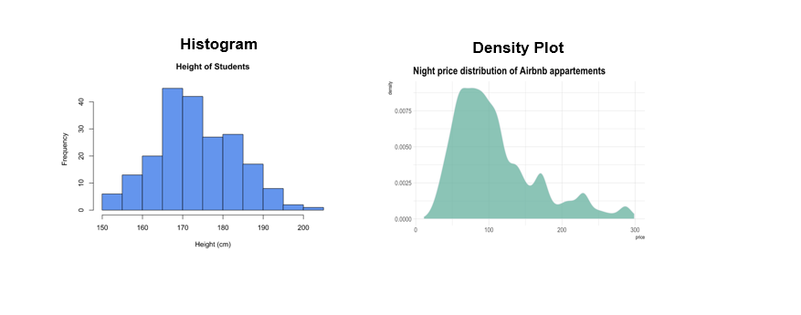
Histograms:
A histogram is similar in appearance to a bar chart. A histogram condenses your data into a series of logical ranges (bars). Each bar shows you how many data points appear.
Density Plot:
This plot is like a histogram, but instead of having separate bars, you get a smooth line to represent the distribution of your data.
Both these plots are great at visually representing the distribution of your data.

Slide 23
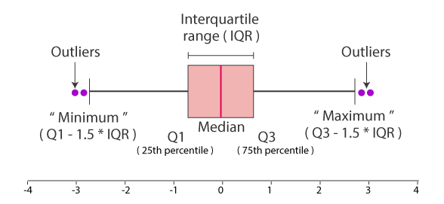
Boxplots
A boxplot is another way of displaying the distribution of your data. This type of graph displays your minimum, maximum, the IQR, your median and the mean.
Median (Q2/50th percentile): The middle value of the data set
First Quartile (Q1/25th percentile): The middle number between the smallest number (not the “minimum”) and the median of the data set
Third Quartile (Q3/75th percentile): The middle value between the median and the highest value (not the “maximum”) of the dataset
Interquartile Range (IQR): 25th to the 75th percentile
Whiskers (shown in black)
Outliers (shown as purple circles)
Maximum : Q3 + 1.5*IQR
Minimum : Q1 -1.5*IQR

Slide 24
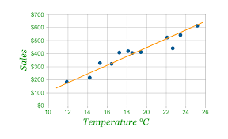
Bivariate Descriptive
Bivariate statistics are inferential statistics that examine the connection between two variables. In other words, bivariate statistics investigates how one variable compares to another or how one variable impacts another.
Bivariate descriptive statistics include studying (comparing) two variables at the same time to see whether there is a link between them. By convention, the columns represent the independent variable and the rows represent the dependent variable.
Scatterplot:
These types of plots show you the relationship between two continuous variables. This relationship can be displayed by a line (usually linear - but it can also be non-linear). A scatterplot uses dots to represent your data. Each dot represents the intersection between the values of the variables you are using.
Note, these are plots, without accompanying data you should not infer that a relationship is statistically significant.

Slide 25
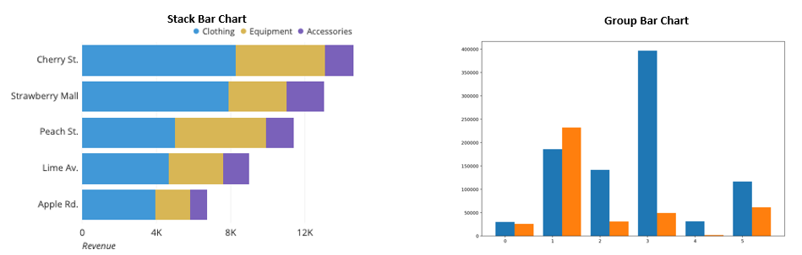
Stacked/Grouped Bar Charts:
These are the same as normal bar charts, except you add splitting the data by another categorical variable.

